Slide 1
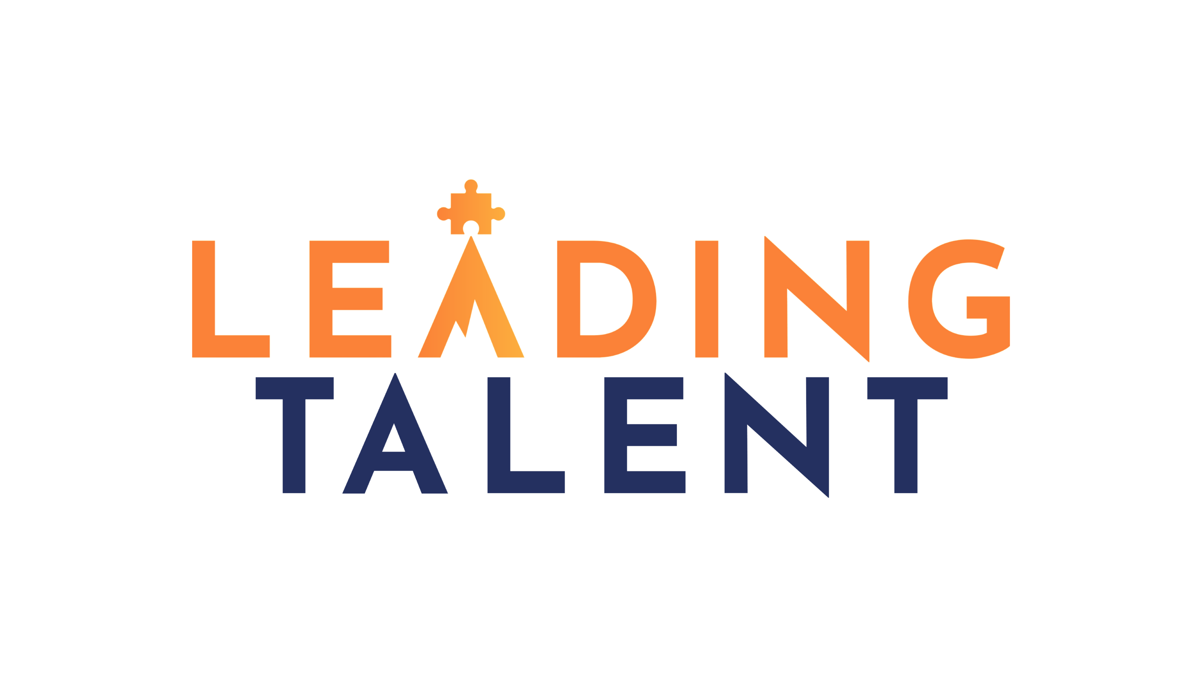
Leading Talent
Case Study - IT Divestiture Services – Business Separation

Slide 2
Leading Talent has delivered end-to-end IT divestiture programmes for organisations separating significant business units.
Resulting in two operationally independent organisations on Day 1 — with clean infrastructure, separated identities, governed data, and fit-for-purpose systems chosen for the future, not inherited by default.

Slide 3
Case Study: Supporting successful business separation from Day One
Client Situation
A large enterprise undertook the strategic divestiture of a significant business unit. The IT estate was deeply entangled — shared Active Directory, co-located infrastructure, mixed data ownership, and no clean boundary between the two organisations.
Legal deadlines were non-negotiable and regulatory obligations created data governance complexity. The carved-out entity had no existing IT function to absorb the new environment, and hundreds of users needed to transition to new identities, platforms and tools without loss of productivity.
Ingestion, ownership and governance of data across ERP, CRM and collaboration platforms was unclear. Downstream, the separation created material risk: operational continuity exposure, unresolved data ownership, and significant contractual liability if the deadline was missed.
The Ask
Design and deliver the full technology separation programme — partitioning infrastructure, migrating users and data, standing up new systems for the carved-out entity, and governing the programme to a legally mandated completion date, while maintaining business continuity for both organisations throughout.
16/06/2026
© 2026 Leading Talent Ltd. All rights reserved.

Slide 4
Leading Talent provided a cross-functional team to deliver the separation programme
What did we do?
The approach focused on pragmatism, legal alignment, and operational independence — not just technical separation.
1
Hardware & Server Migration
Full asset discovery, infrastructure dependency mapping, and a structured plan to partition or replicate shared systems — managing the entire lifecycle from server decommissioning through to new environment build-out, ensuring operational independence on Day 1.
2
User Migration
Active Directory separation, email and M365 platform migration, access rights realignment, and end-user communications planning. User training and post-deployment support ensured people could navigate new systems with confidence from the point of cutover.
3
Data & Systems Migration
Extraction, transformation and loading of data across ERP, CRM and collaboration platforms. Leading Talent managed data pipeline design, integrity validation, and clean authoritative data set delivery — ensuring both parties had governed, trusted data from completion.
4
Overall Programme Governance
Senior programme and project management, RAID management, steering committee support and progress reporting — aligned to legal milestones and stakeholder complexity across both organisations throughout the separation.
5
RFPs for New Systems
Requirements definition, competitive procurement and vendor evaluation for the newly independent entity. Leading Talent ensured new platform choices were aligned to business strategy and fit for purpose from Day 1 — not inherited by default.
16/06/2026
© 2026 Leading Talent Ltd. All rights reserved.

Slide 5
Visual Representation
Entangled IT estate
Shared infrastructure, identity and data — no clean boundary between separating and remaining entity
Shared Active Directory
Co-located servers
Mixed data ownership
No IT function in carved-out entity
Non-negotiable legal deadline
Identity & infrastructure risk
Data integrity & governance gaps
Programme & legal exposure
Shared AD and co-located systems — no separation boundary, no Day 1 readiness
Mixed ownership across ERP/CRM, unclear lineage, unresolved data stewardship
Non-negotiable completion date, contractual liability, no IT function to absorb change
Downstream business impact
Operational continuity risk
Productivity loss during transition
Conflicting data on legal completion
Contractual deadline exposure
End-to-end divestiture programme
Infrastructure · Identity · Data · Governance · New systems — two clean organisations, operationally independent on Day 1
Day 1 operational independence
Clean data sets for both parties
Fit-for-purpose new systems
Estate
Problems
Impact
Solution
16/06/2026
© 2026 Leading Talent Ltd. All rights reserved.

Slide 6
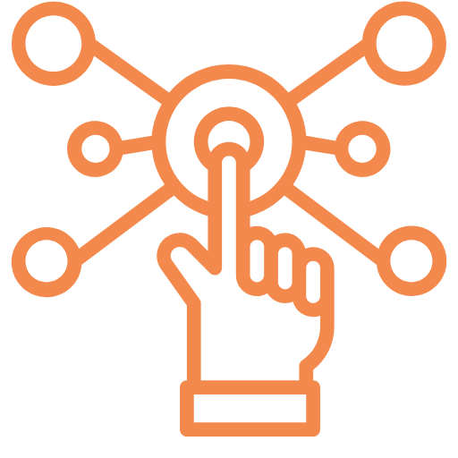
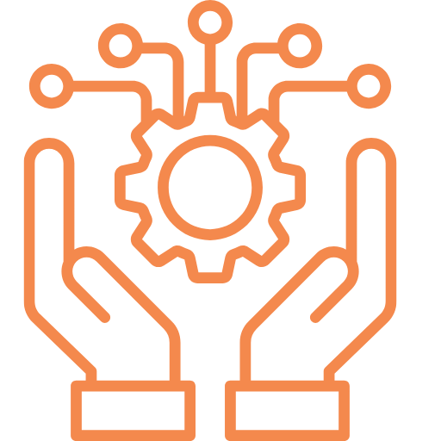
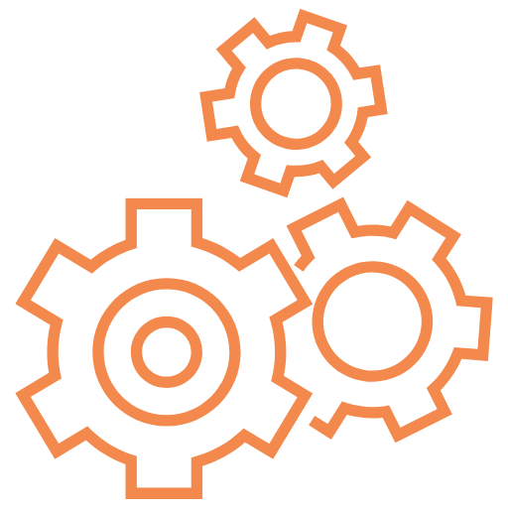
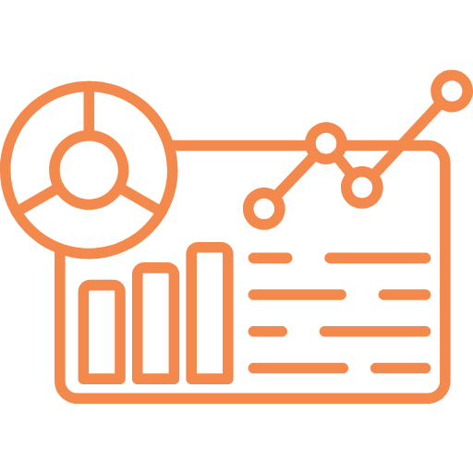
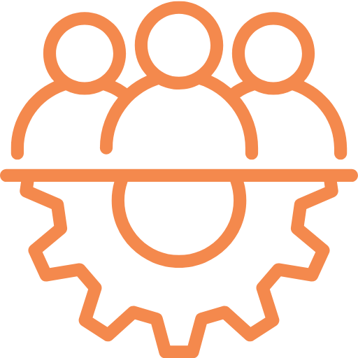
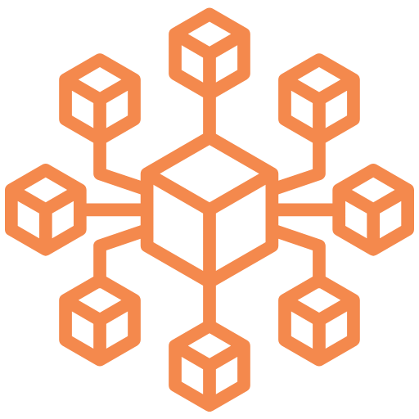
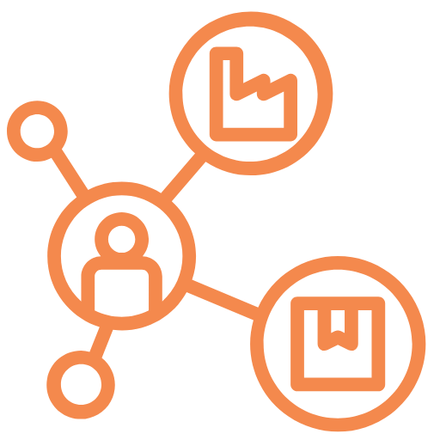
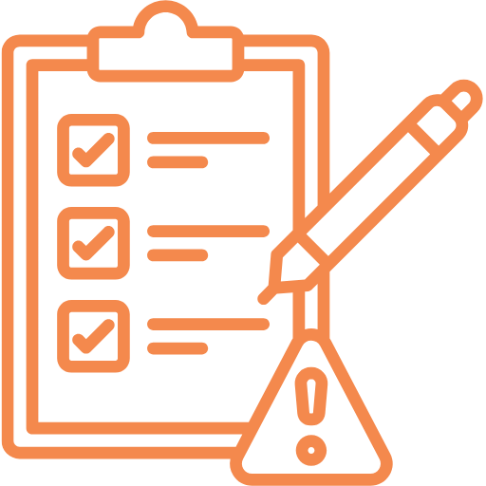

At Leading Talent, we don’t just provide solutions, we lead the way
With deep industry knowledge and a commitment to innovation, we offer strategic guidance and hands-on support to help businesses navigate complex challenges. Our team of experts works closely with clients to develop customised solutions that align with their goals, ensuring sustainable success and measurable impact.
Digital IT & Business Transformation
Project Management
Technical & Solution Architecture
Data and Analytics
Business Application Implementations
OS Deployment & System Migration
Digital Supply Chain
Business Continuity & Emergency Planning
Cybersecurity

